Slide 1


Major Project
Title: Fire Detection using YOLO
Presented by:
Roll number - R2142221445 Gauransh Chauhan

Slide 2
Content
Introduction
Literature Review
Objectives
Methodology
Working Model
Results
Conclusion
References
Colour Code:
Synopsis: Red
Mid term: Orange
End Term: Purple
Note: The Following presentation will have all the content of the later.

Slide 3
Introduction
Problem: Fire accidents at home cause heavy damage and loss of life. Early detection is crucial to prevent disasters.
Solution: We are developing a real-time fire detection system that recognizes flames and smoke from images.
Applications: Useful in smart homes, IoT surveillance, emergency response, and industrial safety.
Dataset: About 6,500 images of indoor fire scenarios (flames & smoke in varied conditions), with YOLO-format annotations for training and testing.
Technology: Built using YOLOv8 (a modern deep learning model in PyTorch) with data augmentation to improve learning.
Evaluation: Performance measured with mAP (mean Average Precision), showing how accurately the system detects fires.

Slide 4
Literature Review
Earlier studies used basic computer vision and CNN models for fire detection, but they often failed to detect fires quickly in their early stages because the flames/smoke were small, faint, easily confused with background, and training datasets were limited.
Strength: Real-time detection
Weakness: Requires large dataset and GPU resources
Opportunity: Integration with smart devices like smartphone app, smart camera, home camera etc.
Threat: Dataset bias and false alarms causing false possitive

Slide 5
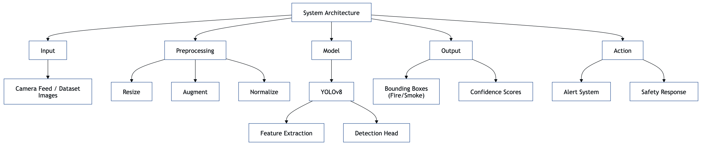
Objective
To develop a real-time, accurate, and reliable fire detection system using YOLOv8 that can accurately recognize flames and smoke in indoor environments.

Slide 6
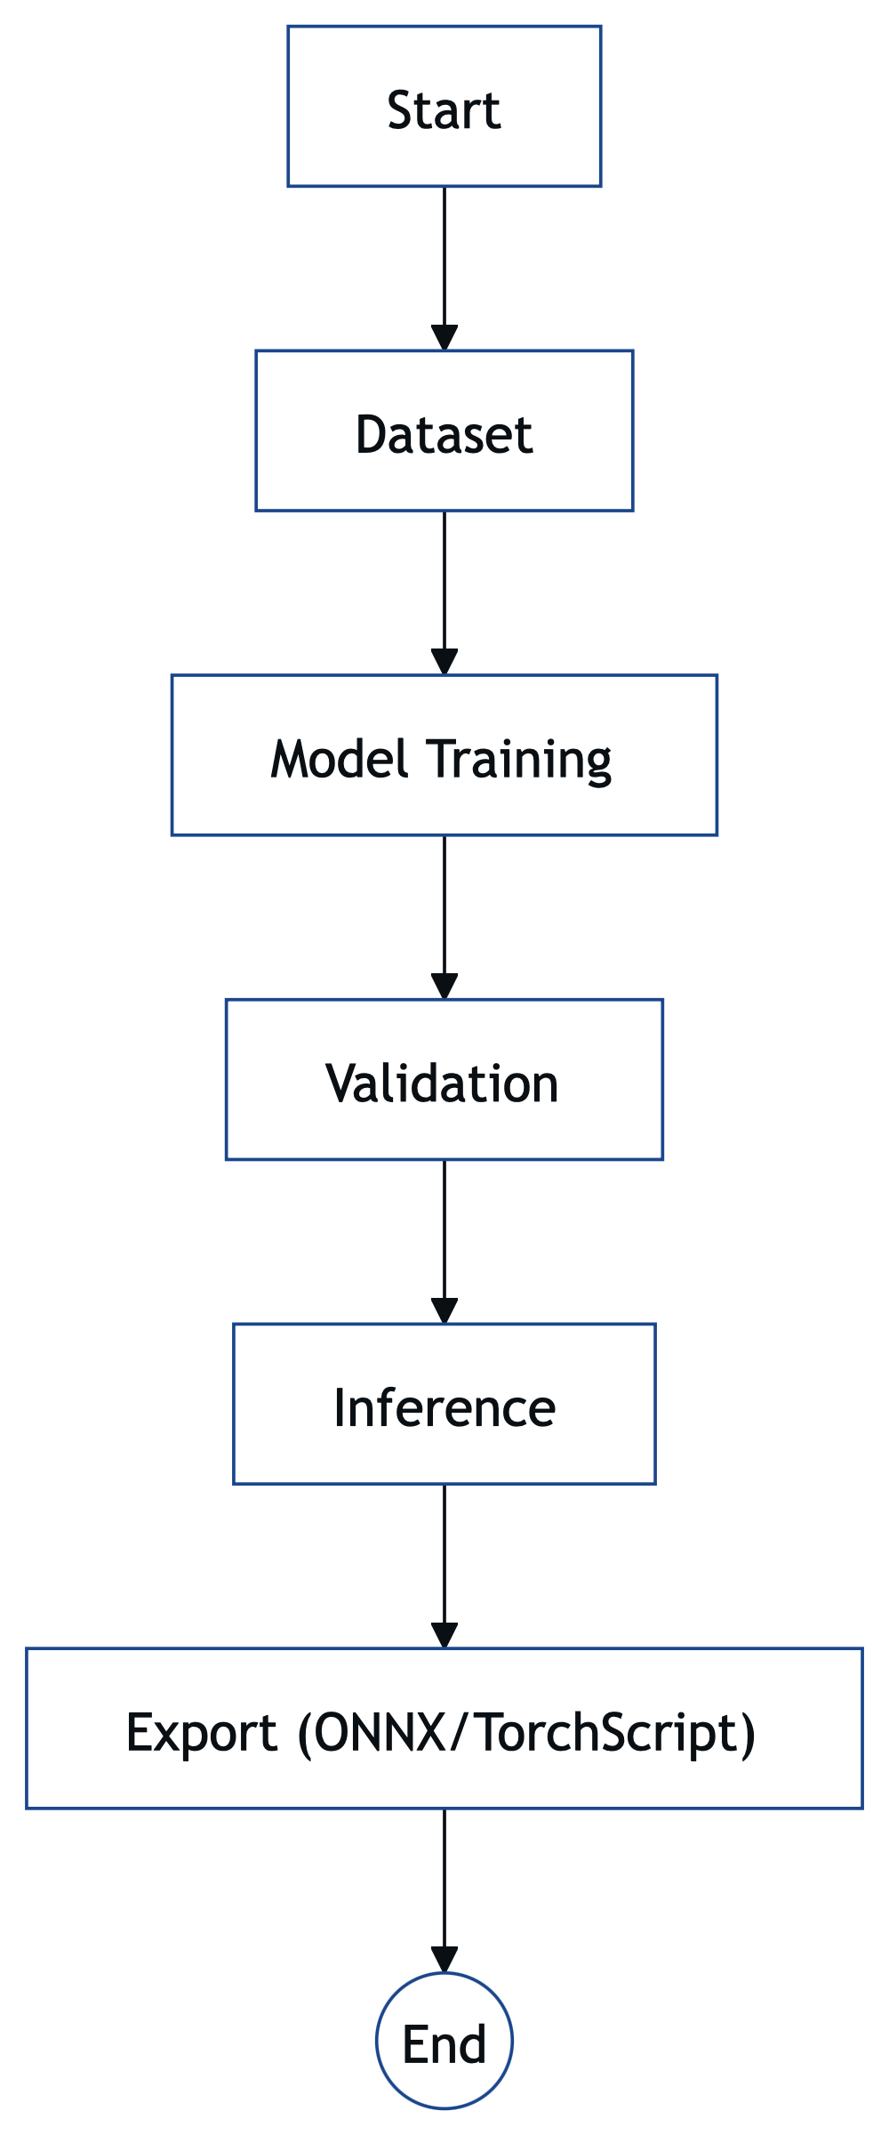
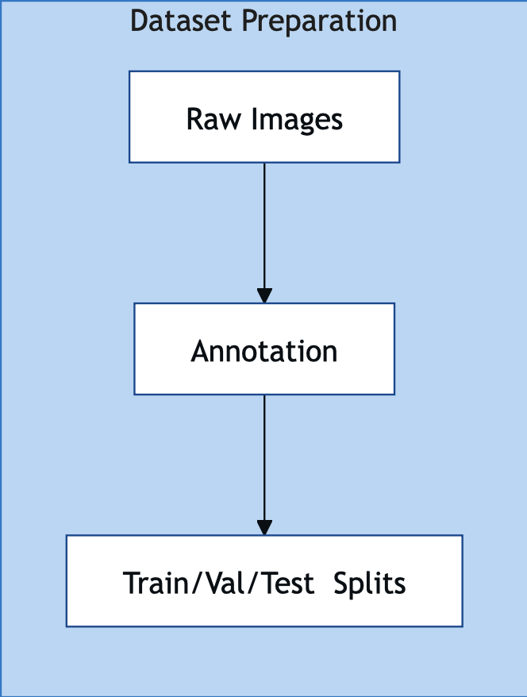
Methodology
Reference Software Model
YOLOv8 object detection model (Ultralytics, PyTorch-based).
Steps
Dataset Preparation - Collect and structure ~6,500 fire images with YOLO-format annotations.
Data Verification - Check correctness of labels and dataset splits (train/validation/test).

Slide 7
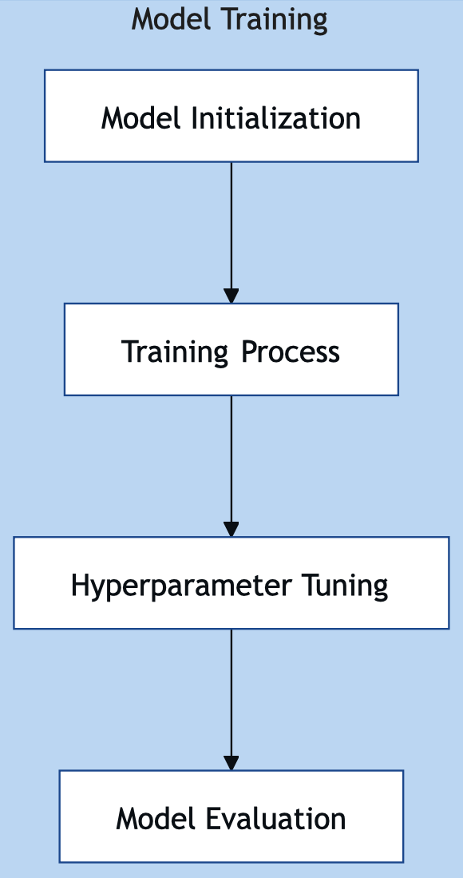
(Continued steps)
Model Training - Train YOLOv8 with optimized hyperparameters (epochs, batch size).
2. Model Validation - Evaluate accuracy using mAP, precision, recall.
3. Inference Testing - Test model on unseen images/videos to check real-world performance.
4. Model Export - Convert trained model into deployable formats (ONNX, TorchScript).
5. Visualization & Analysis - Generate plots (loss curves, precision-recall) and analyze results.

Slide 8
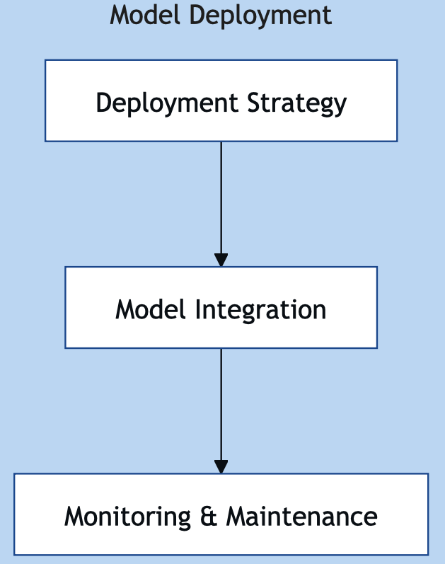
3.Deliverables
A trained YOLOv8 fire detection model.
Performance evaluation metrics and visualizations.
Exported model files ready for deployment.
4.Timeline
Week 1–2 → Dataset preparation & verification
Week 3–5 → Model training
Week 6 → Validation & inference testing
Week 7 → Export & analysis
Week 8 → Documentation & presentation

Slide 9
Reference
List of cited papers:
Bochkovskiy, A., Wang, C.Y., & Liao, H.Y.M. (2020). YOLOv4: Optimal Speed and Accuracy of Object Detection.arXiv:2004.10934.
Jocher, G., et al. (2023). YOLOv8: Ultralytics Official Implementation. GitHub Repository.
Muhammad, K., et al. (2018). Efficient Fire Detection for Uncertain Surveillance Environment. IEEE Transactions on Industrial Informatics.
Peng, J., Feng, T., & Liu, C. (2022). Home-Fire Dataset. Kaggle. https://www.kaggle.com/datasets/pengbo00/home-fire-dataset
Krizhevsky, A., Sutskever, I., & Hinton, G.E. (2012). ImageNet Classification with Deep Convolutional Neural Networks.NeurIPS.

Slide 10
Thank You

